Slide 1
HACK -TRACK
Domain:AppDev/WebDev
LET’S CODE
Aditya kumar -Information Technology 2022-26
Ankit kumar -Information Technology 2022-26

Slide 2
Problem Statements :
After writing few hundred lines of codes the next written codes stop working.
It was difficult to upload the codes and files to server(github).
Setting the perfect size and position of the image.
Solution:
It get solved when we copy paste the same code in the upper side of the lines.
We used netlify which was easy to use handle and upload the codes
We get the perfect position and size after many try and run

Slide 3
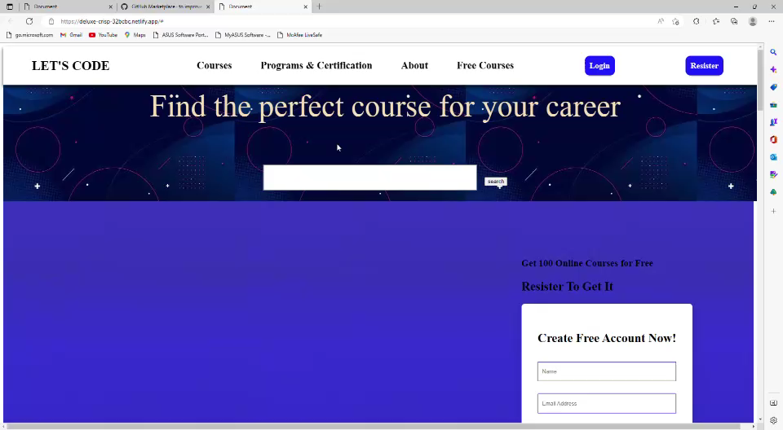
PROJECT DEMO:
LINK:
https://chipper-biscotti-92145a.netlify.app/

Slide 4
FUTURE GOALS: To provide the free courses to
the students
FEATURES TO BE ADDED IN FUTURE:
We will add more and more free content
We will update the looks and presentation of the site
We will make it as a popular site

